Slide 1
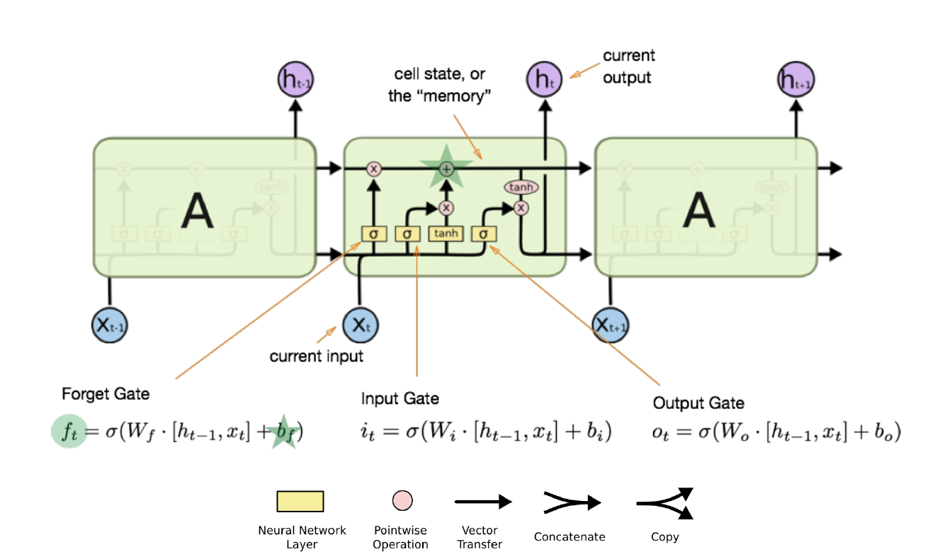
LSTM Networks

Slide 2
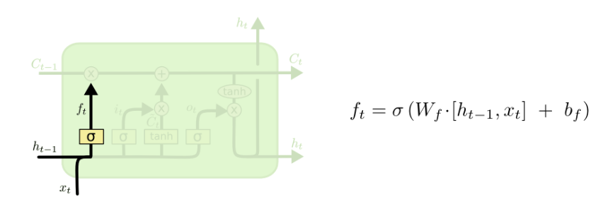
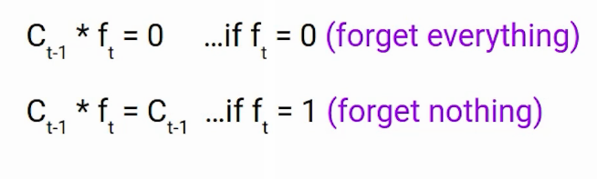
Forget Gate

Slide 3
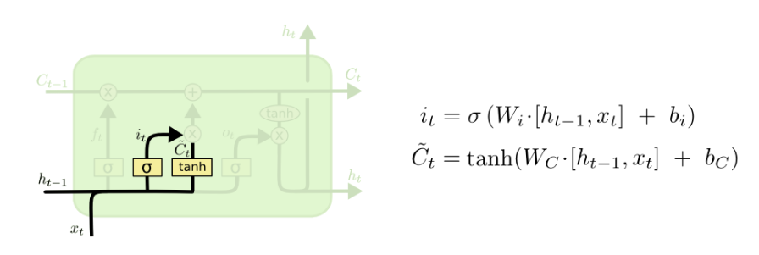
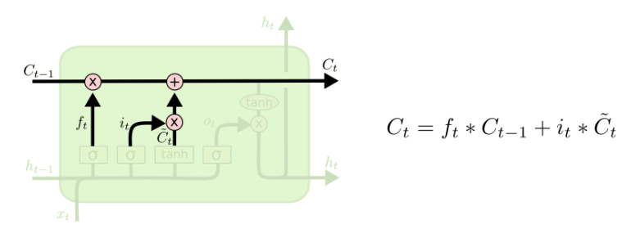
Input Gate

Slide 4
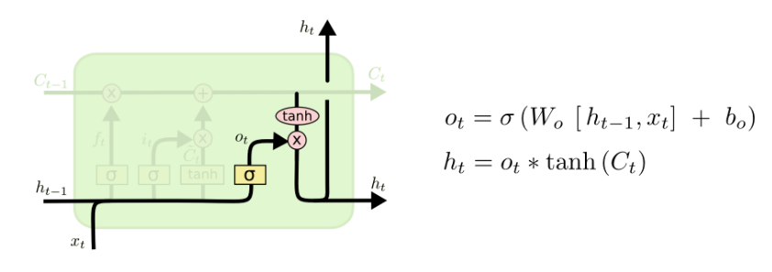
Output Gate

Slide 5
Visual Representation of LSTM

Slide 6
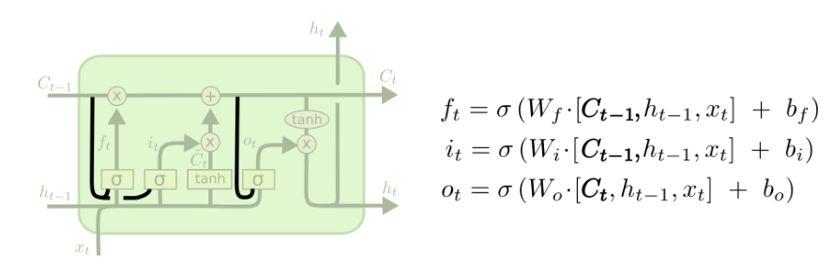
Variants of LSTM Peephole LSTM
In this Network we let the gate layers look at the cell state

Slide 7
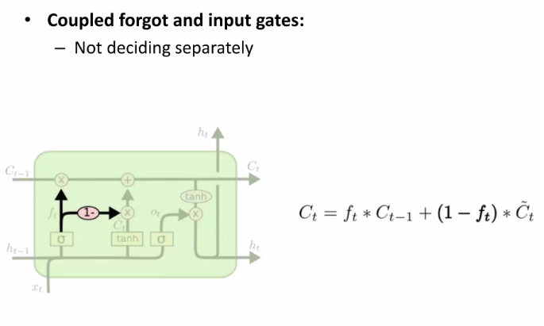
Coupled forget and input gates
In this variant Instead of separately deciding what to forget and what we should add new information to, we make those decisions together. We only input new values to the state when we forget something older.

Slide 8
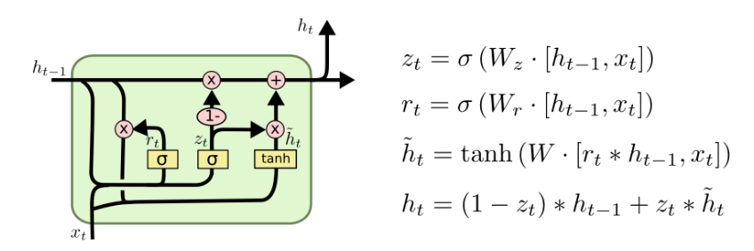
Gated Recurrent Unit (GRU)
It combines the forget and input into a single update gate.
It also merges the cell state and hidden state. This is simpler than LSTM. There are many other variants too.

Slide 9
Visual Representation of GRU

Slide 10
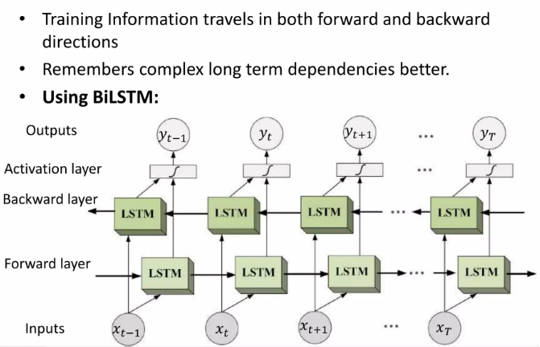
Bi-LSTM
Bidirectional recurrent neural networks(RNN) are putting two independent RNNs together. This structure allows the networks to have both backward and forward information about the sequence at every time step.

Slide 11
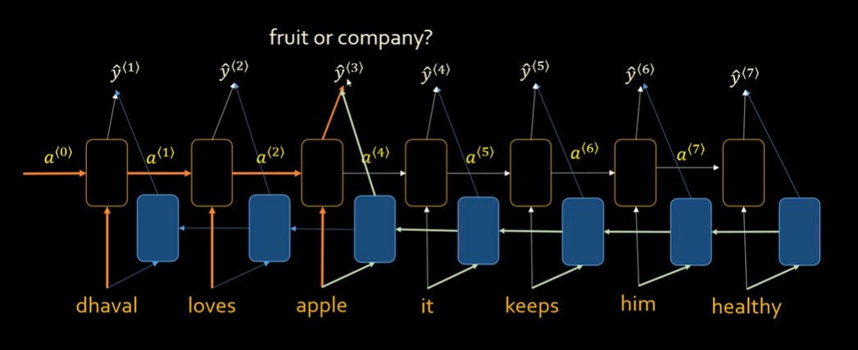

Slide 12
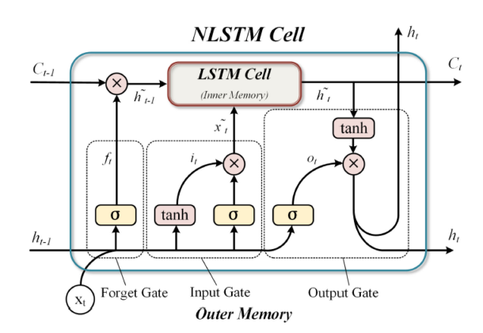
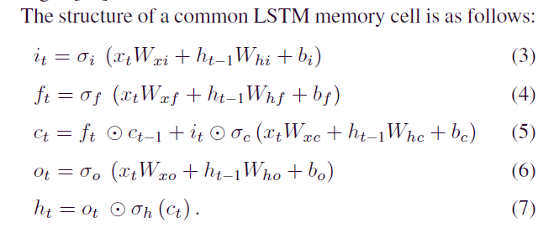

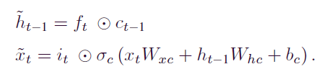
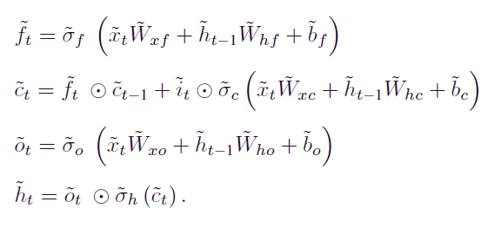



Multivariate Air Quality Forecasting With Nested Long Short Term Memory Neural Network

Slide 13
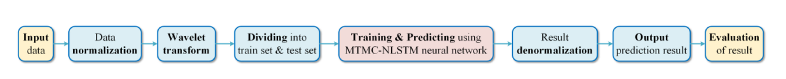
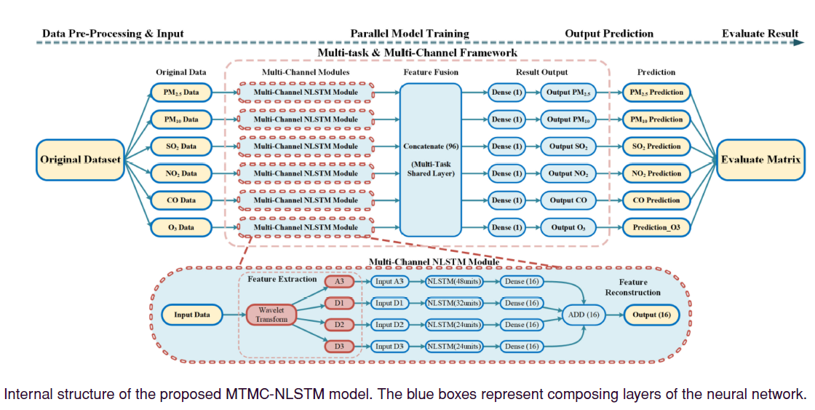

Slide 14
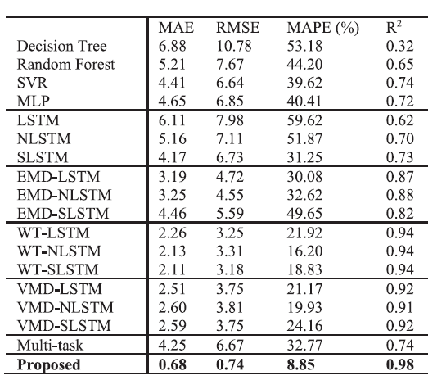
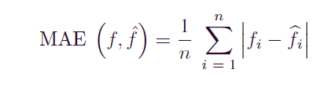
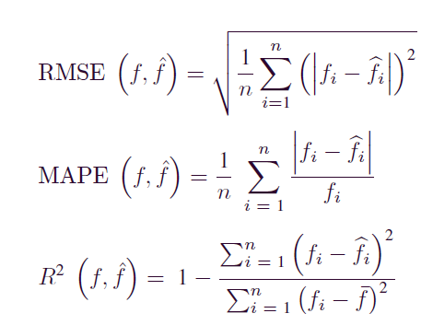
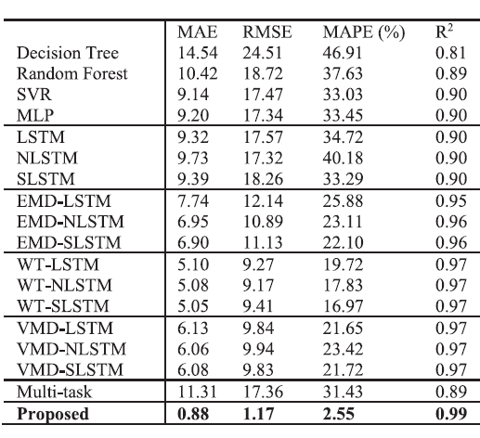
Evaluation Matrix
No2
PM2.5

Slide 15
Thank You !

Slide 16
